Slide 1

WELCOME!

Slide 2
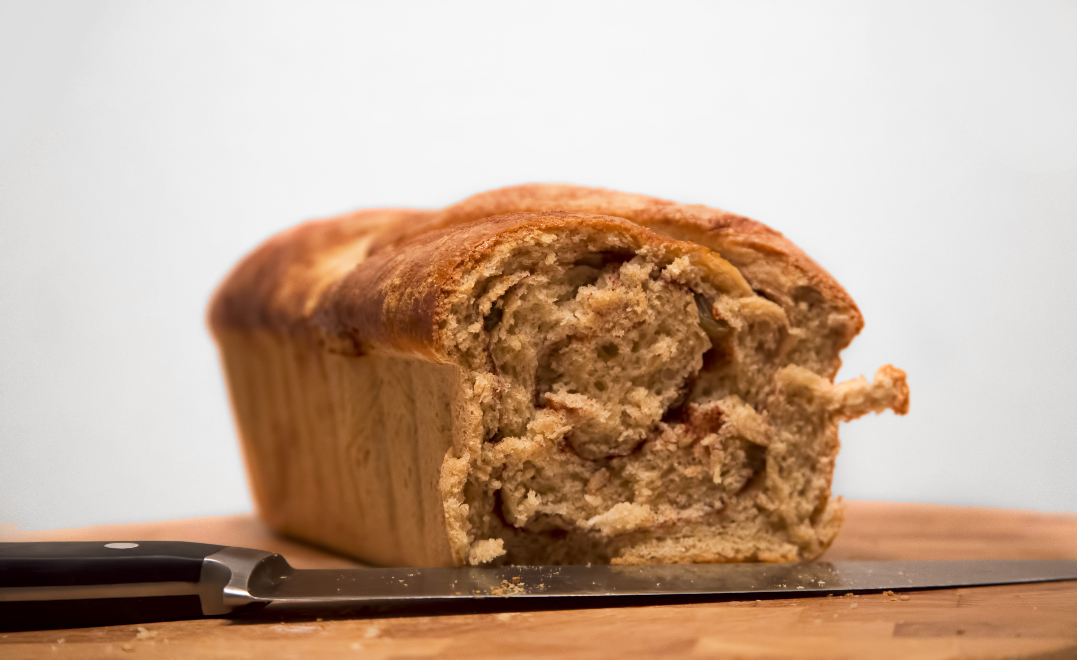
Team Kitchen Coders
Apexa Patel
Louise Miller
Navin Udiaver
Alex Reinking
Evan Nelson

Slide 3

An Express Web Application

Slide 4
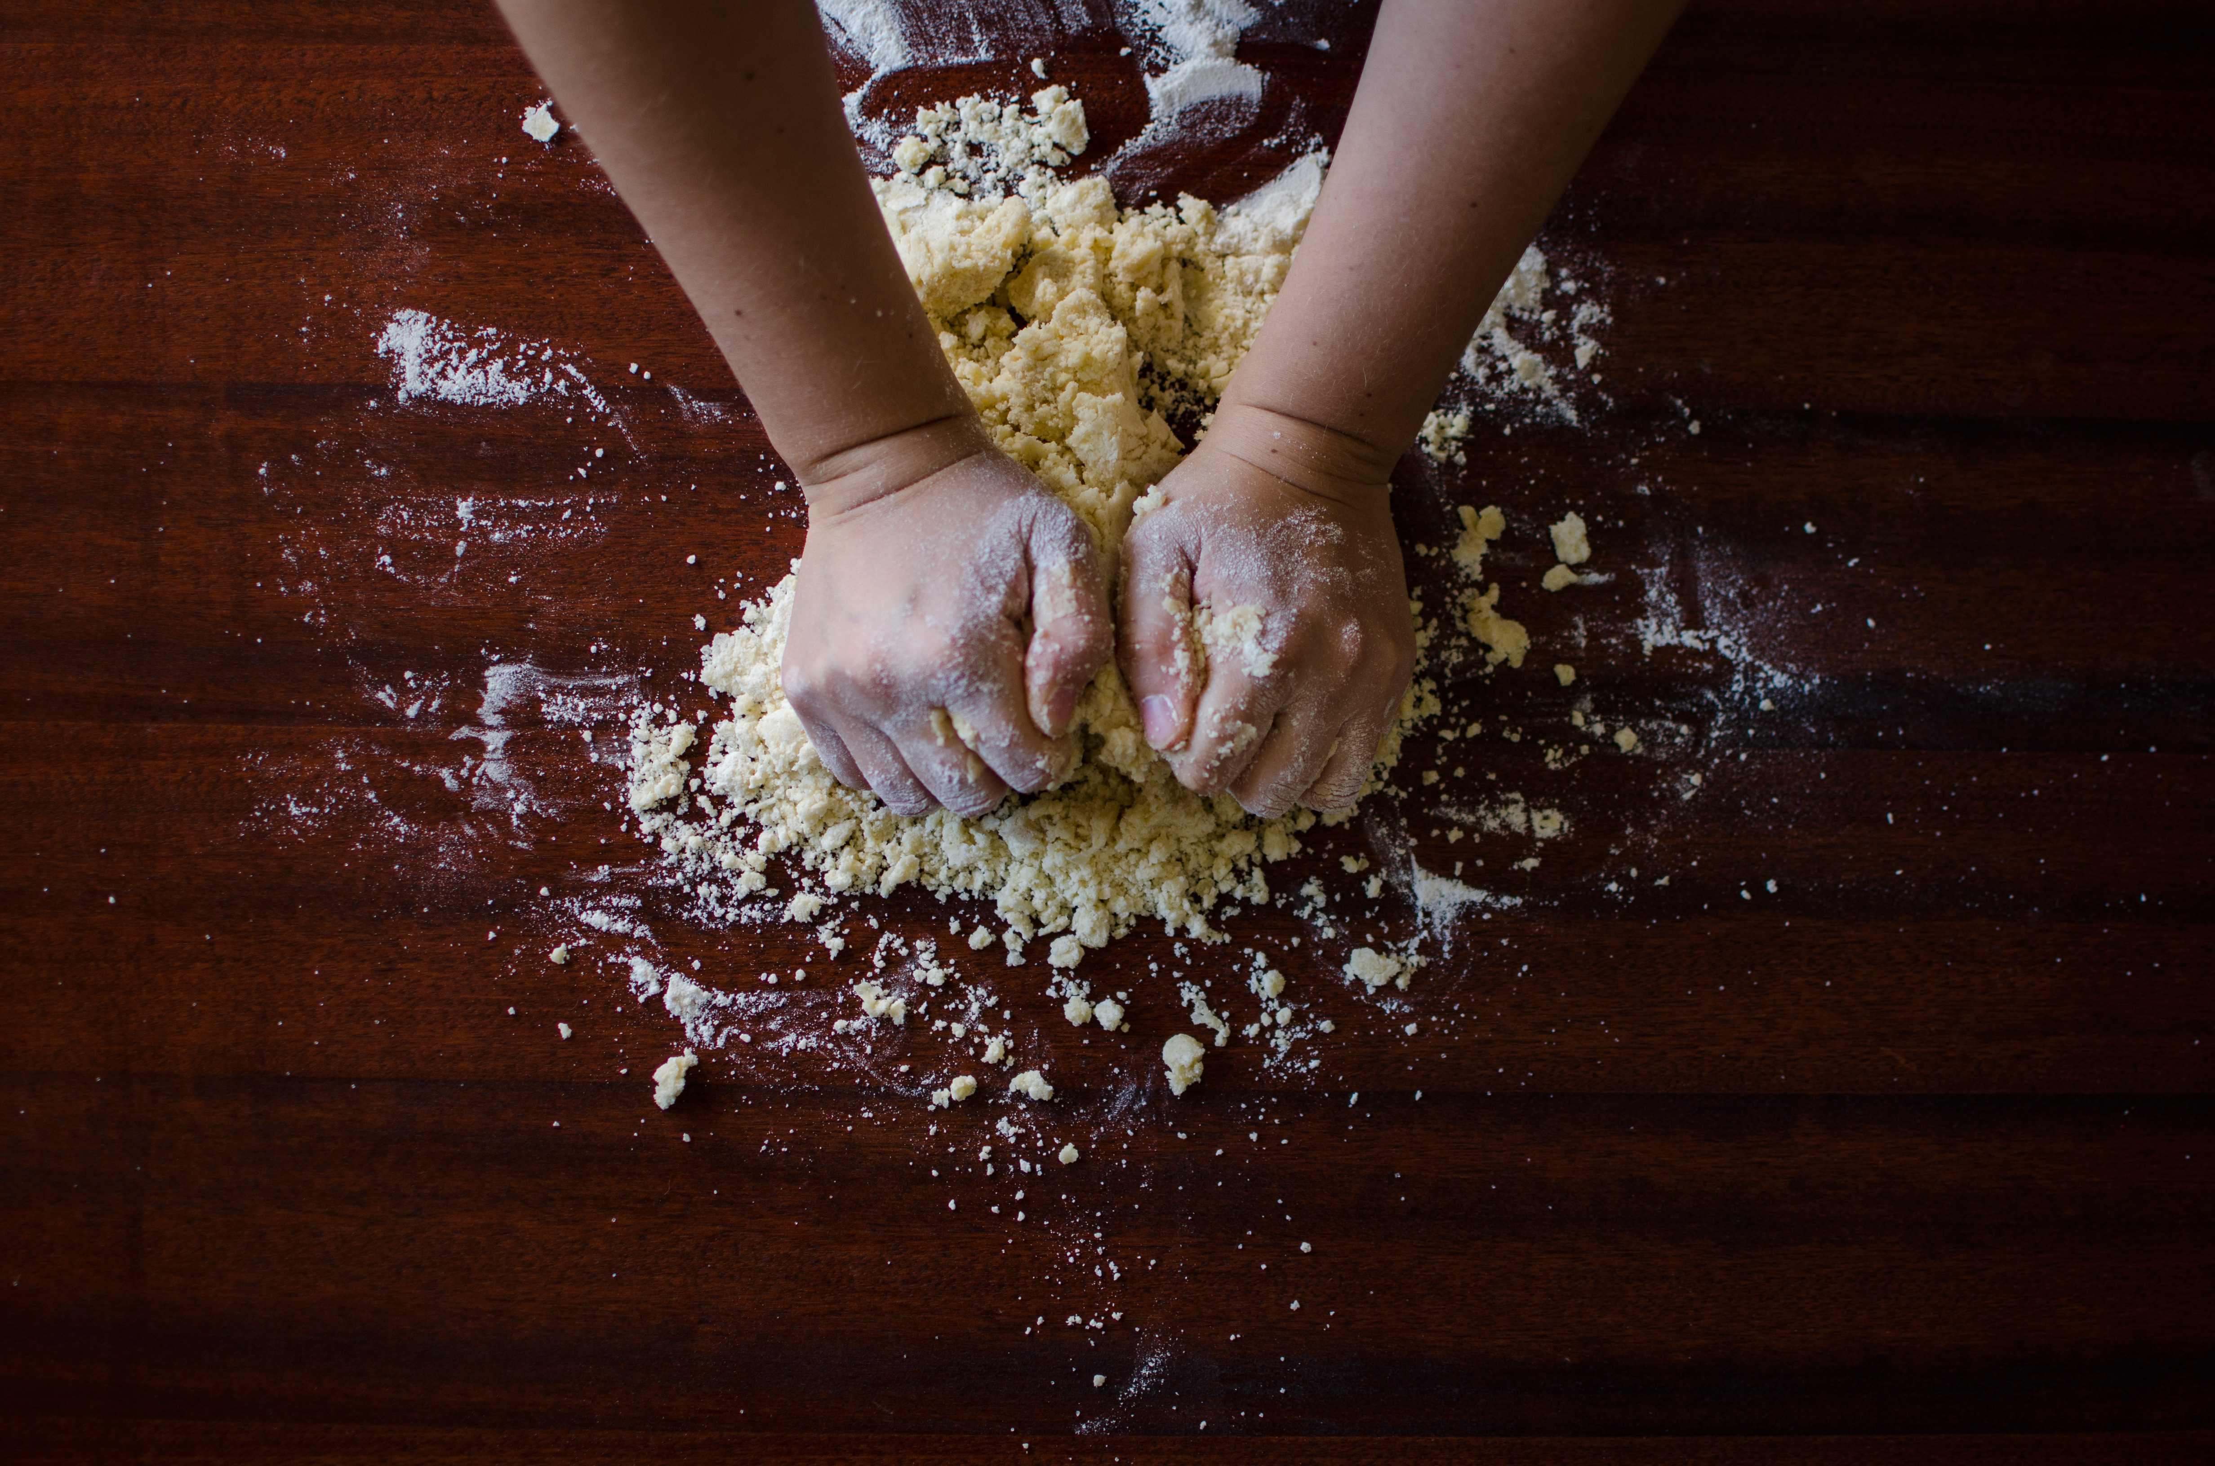
Node.js
Express
Sequelize
Spoonacular
Handlebars
Bootstrap

Slide 5

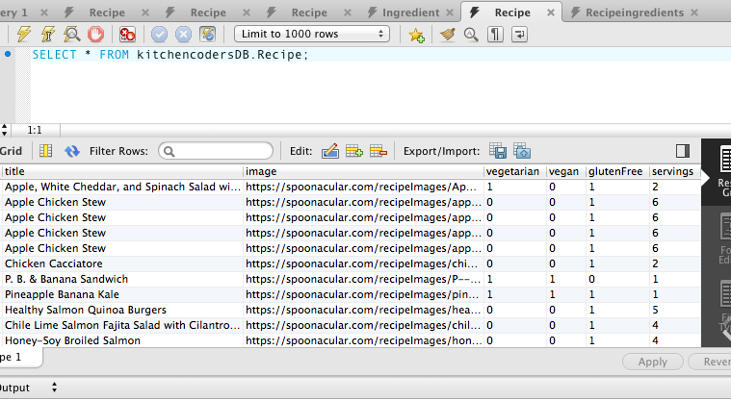
RECIPE

Slide 6
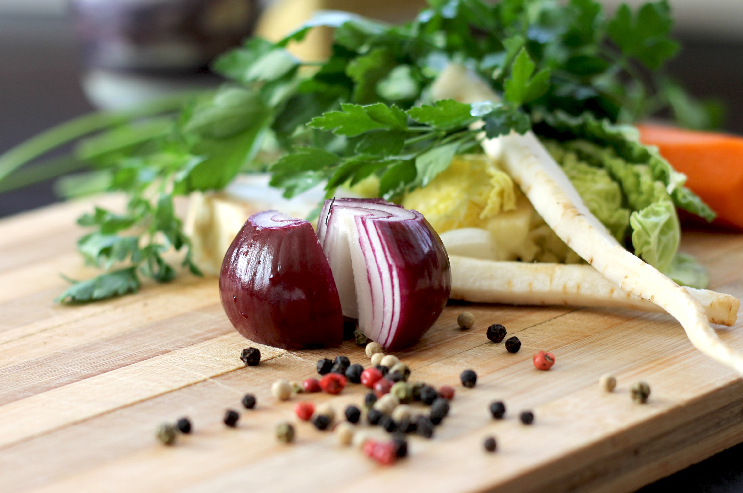
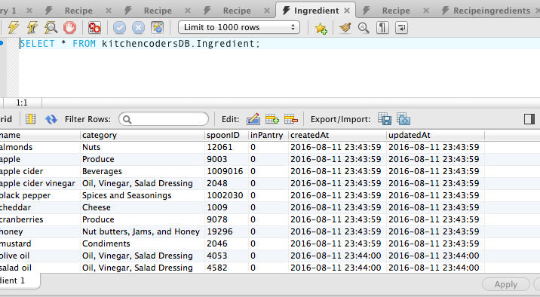
INGREDIENTS

Slide 7
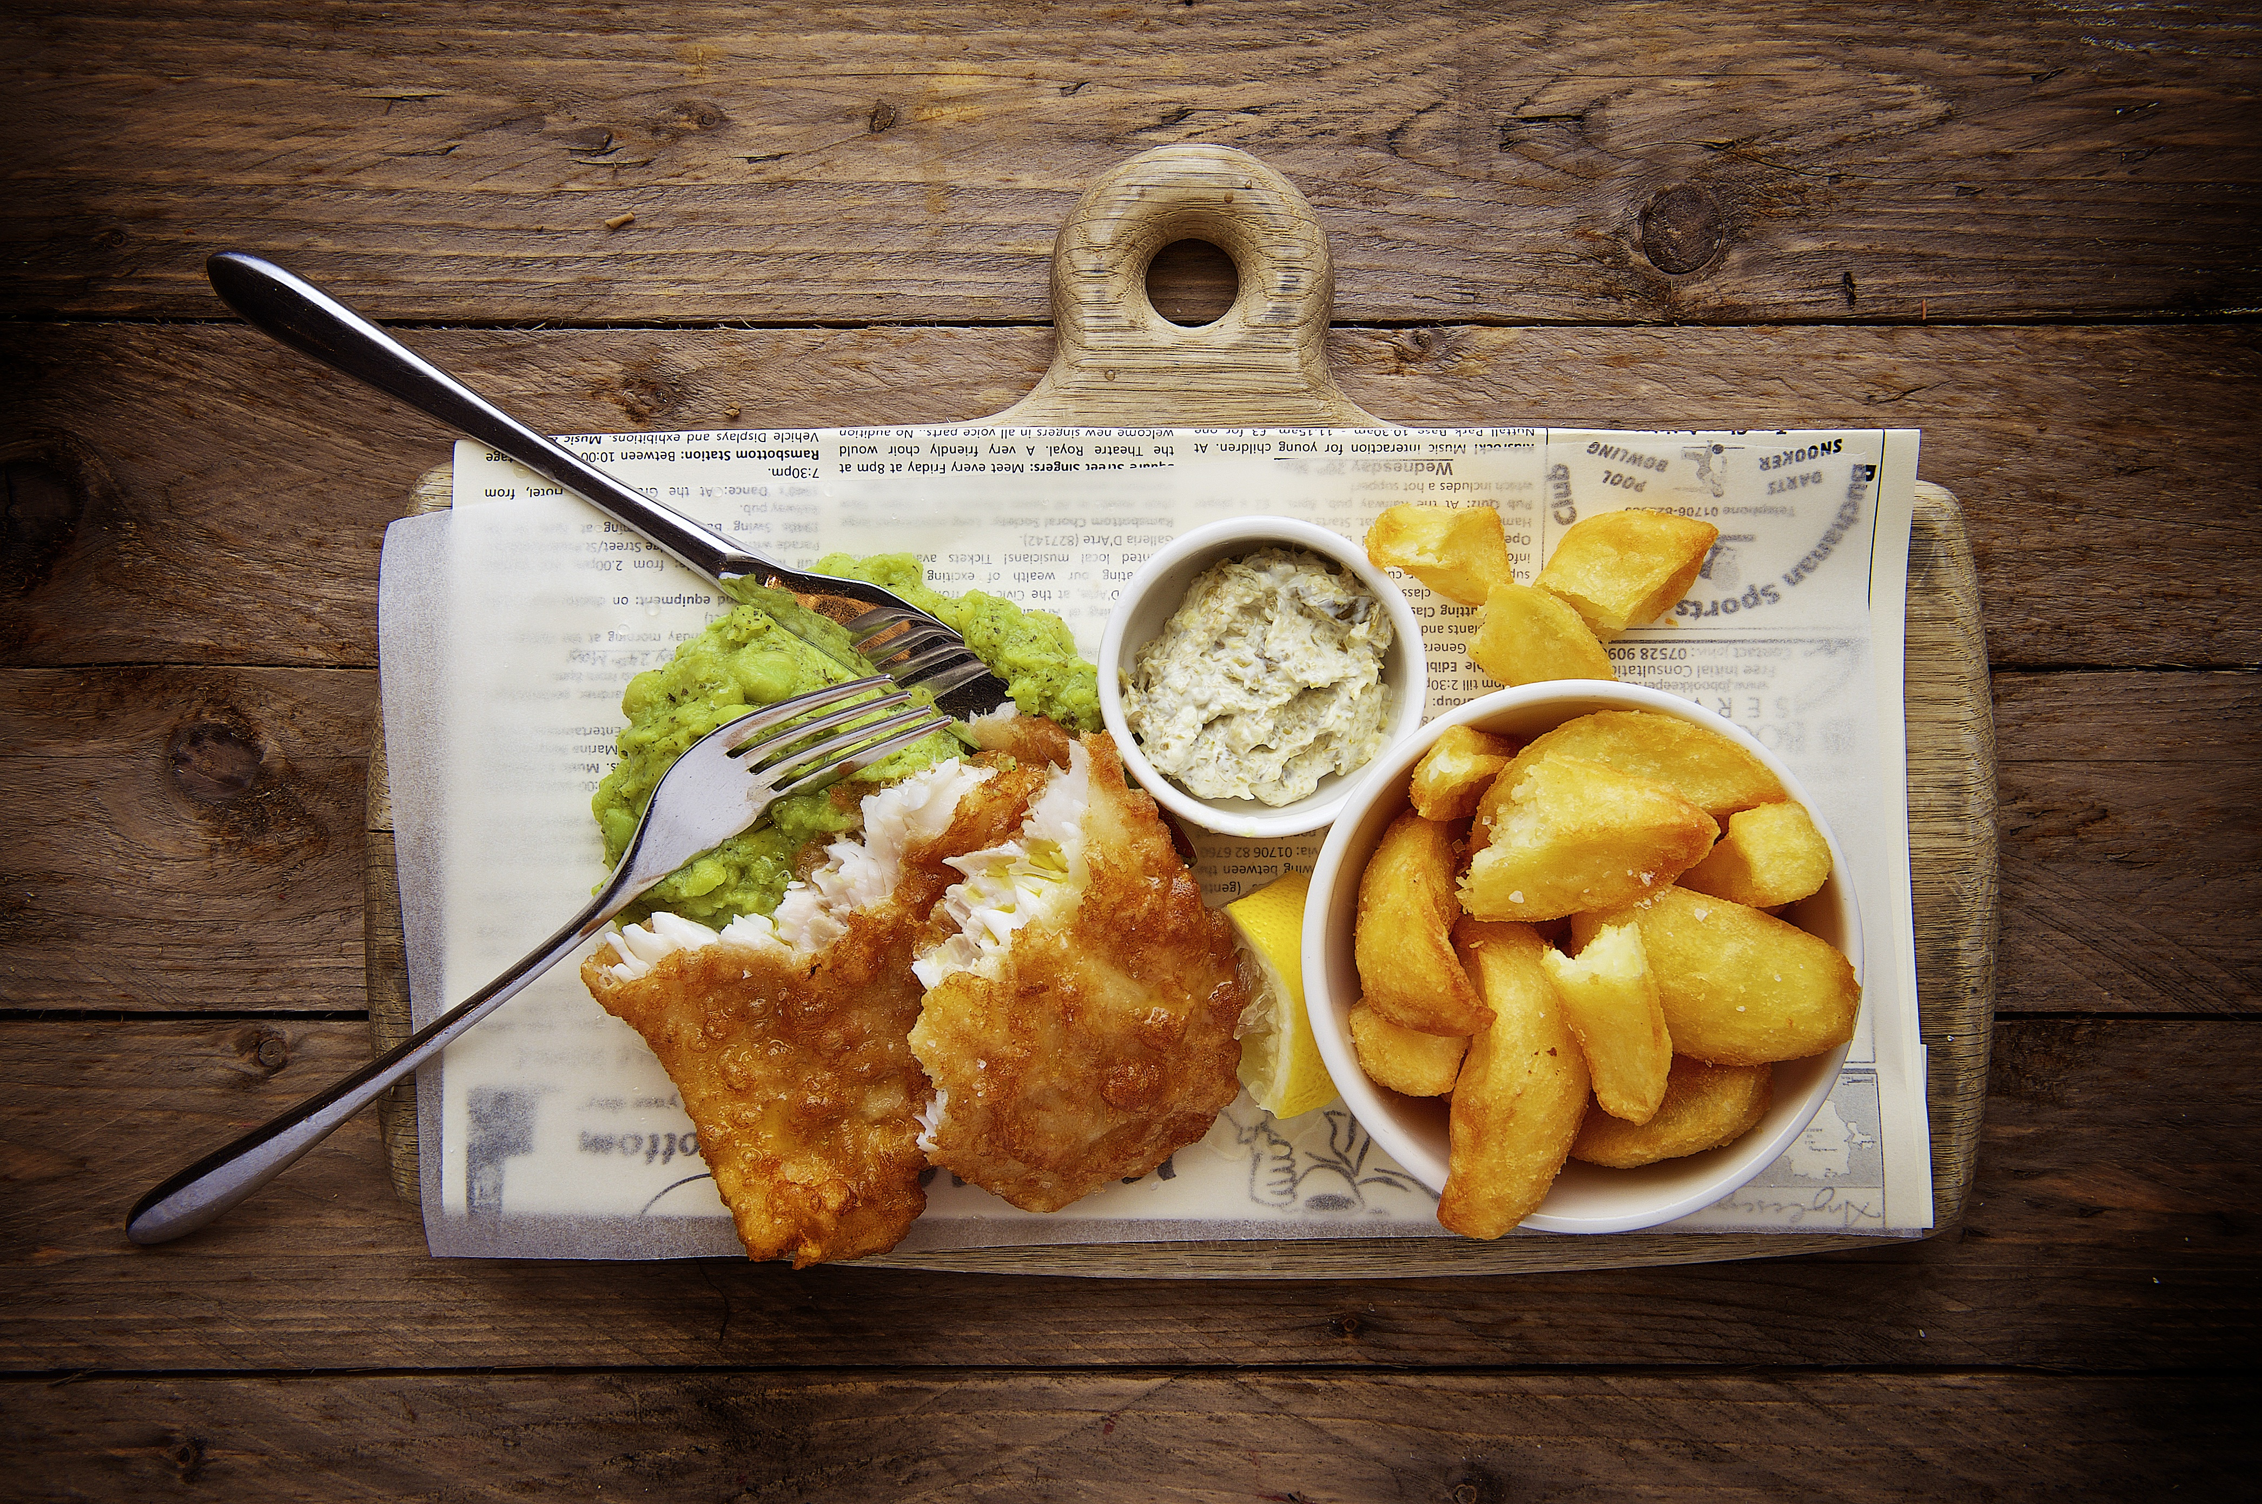
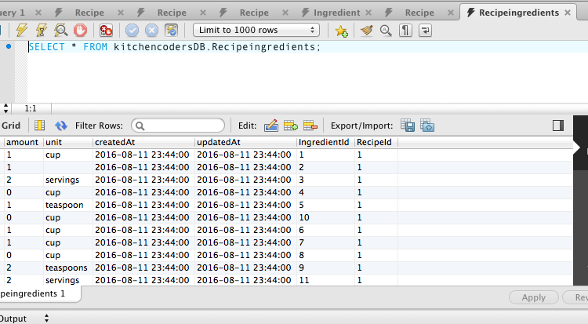
RECIPE INGREDIENTS

Slide 8
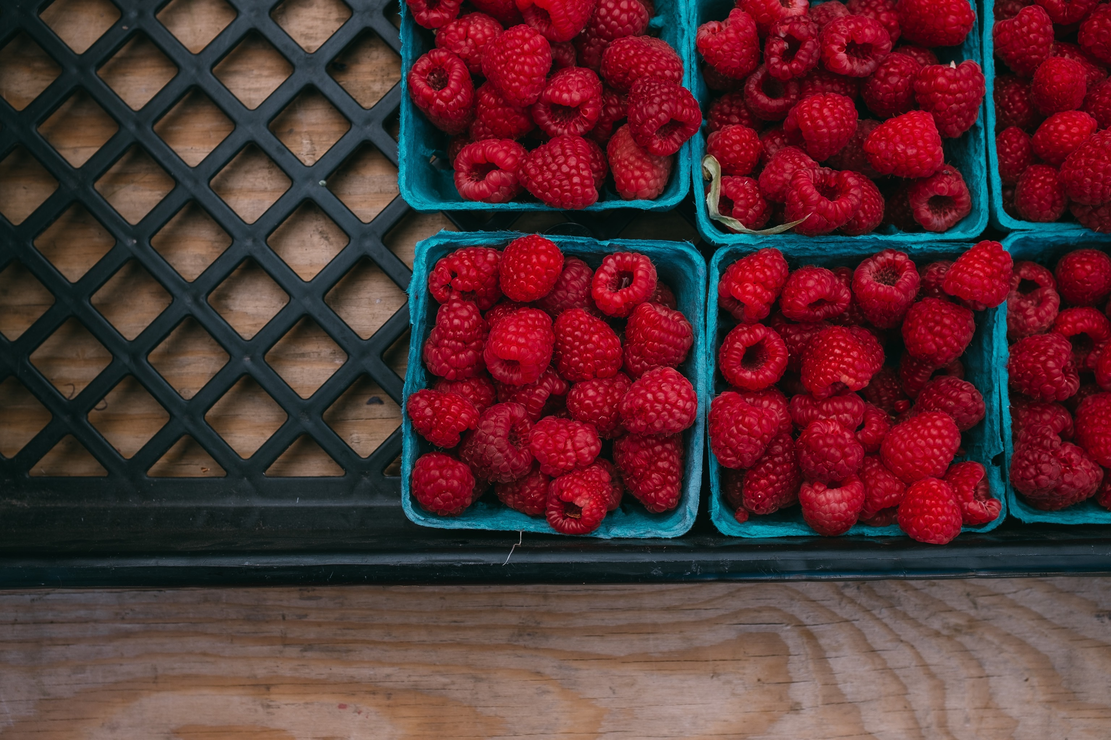
Plans for Future Dev
Scale for more users
Add more search terms
Allow for user preferences
Allow user to mark favorites
Share with your friends!

Slide 9
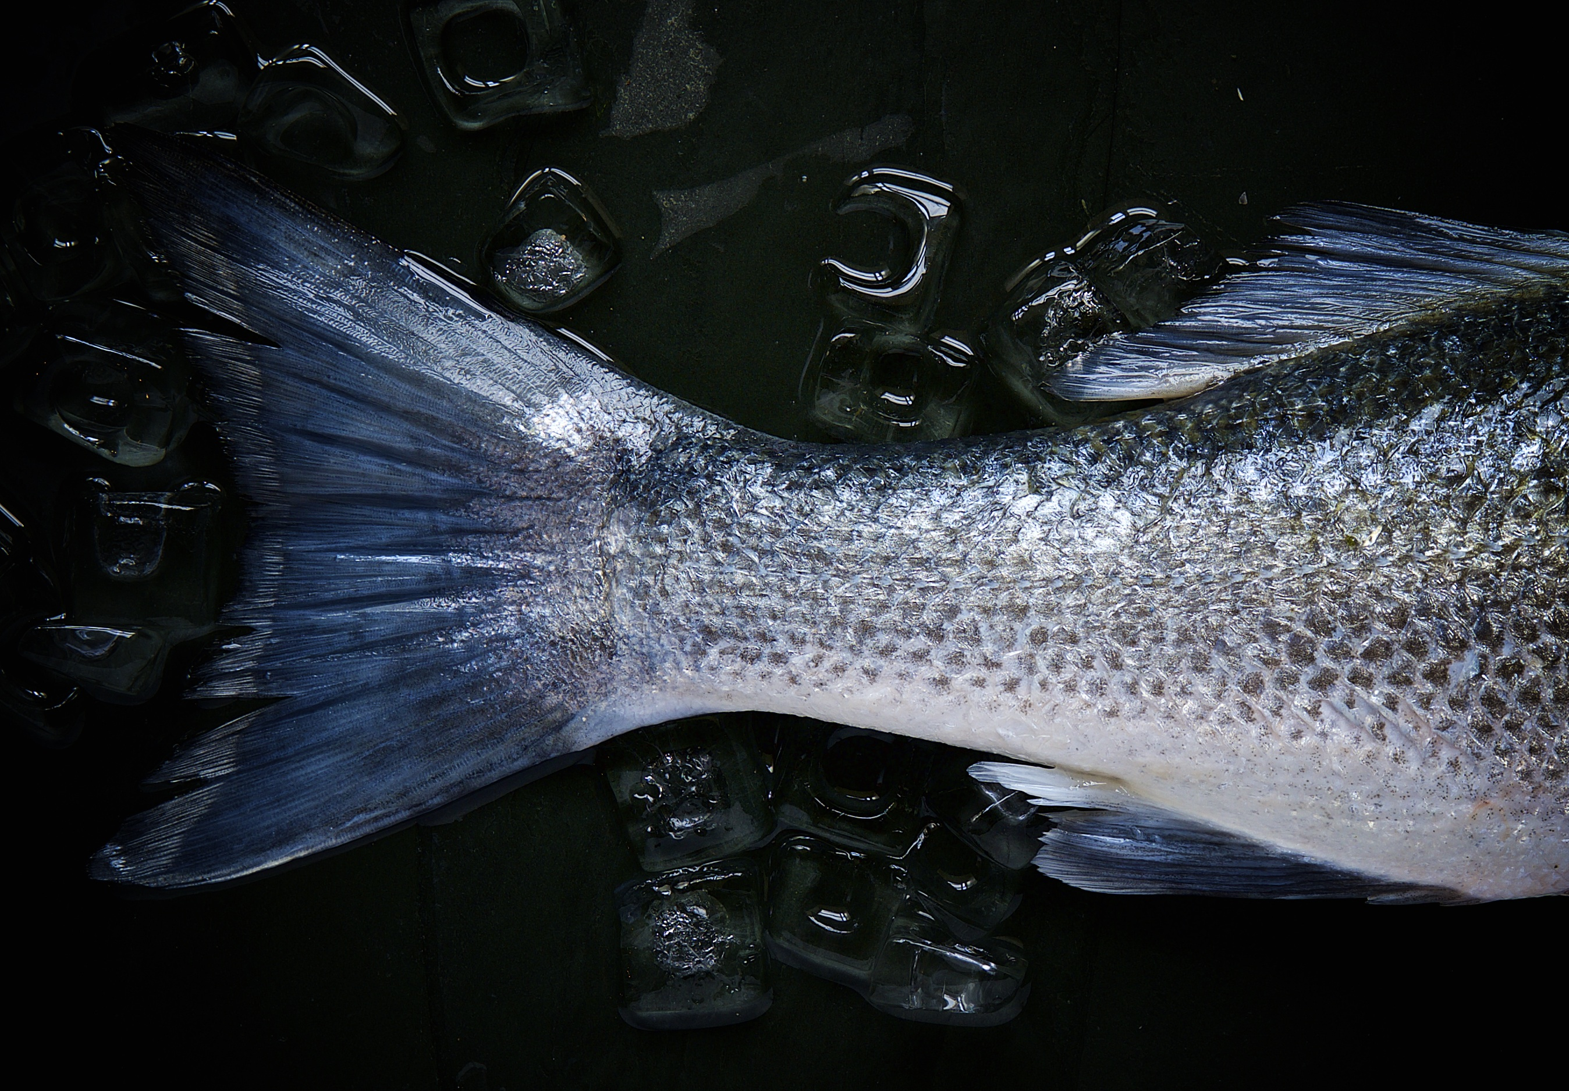
FIN
louise@txmiller.com
apexa0630@outlook.com
evnelson.315@gmail.com
navin.udiaver@gmail.com
alex_reinking@yahoo.com

